Slide 1
B+ Trees
Brian Lee
CS157B Section 1
Spring 2006

Slide 2
Table of Contents
History of B+ Trees
Definition of B+ Trees
Searching in B+ Trees
Inserting into B+ Trees
Deleting from B+ Trees
Works Cited

Slide 3
History of B+ Trees
First described in paper by Rudolf Bayer and Edward M. McCreight in 1972
"Rudolf Bayer, Edward M. McCreight: Organization and Maintenance of Large Ordered Indices. Acta Informatica 1: 173-189 (1972)“ --Wikipedia

Slide 4
Description of B+ Trees
A variation of B-Trees
B-Trees commonly found in databases and filesystems
Sacrifices space for efficiency (not as much re-balancing required compared to other balanced trees)

Slide 5
Description of B+ Trees (cont.)
Main difference of B-Trees and B+ Trees
  B-Trees: data stored at every level (in every node)
  B+ Trees: data stored only in leaves
    Internal nodes only contain keys and pointers
    All leaves are at the same level (the lowest one)

Slide 6
Description of B+ Trees (cont.)
B+ trees have an order n
An internal node can have up to n-1 keys and n pointers
Built from the bottom up

Slide 7
Description of B+ Trees (cont.)
All nodes must have between ceil(n/2) and n keys (except for the root)
For a B+ tree of order n and height h, it can hold up to n^{h} keys

Slide 8
Searching in B+ Trees
Searching just like in a binary search tree
Starts at the root, works down to the leaf level
Does a comparison of the search value and the current “separation value”, goes left or right

Slide 9
Inserting into a B+ Tree
A search is first performed, using the value to be added
After the search is completed, the location for the new value is known

Slide 10
Inserting into a B+ Tree (cont.)
If the tree is empty, add to the root
Once the root is full, split the data into 2 leaves, using the root to hold keys and pointers
If adding an element will overload a leaf, take the median and split it

Slide 11
Inserting into a B+ Tree (cont.)
Example:
  Suppose we had a B+ tree with n = 3
    2 keys max. at each internal node
    3 pointers max. at each internal node
    Internal nodes include the root

Slide 12
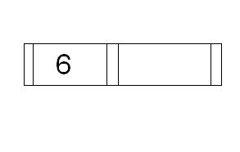
Inserting Into B+ Trees (cont.)
Case 1: Empty root
Insert 6

Slide 13
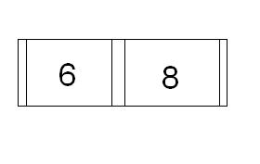
Inserting into B+ Trees (cont.)
Case 2: Full root
Suppose we have this root:
In order to insert another number, like 5, we must split the root and create a new level.

Slide 14
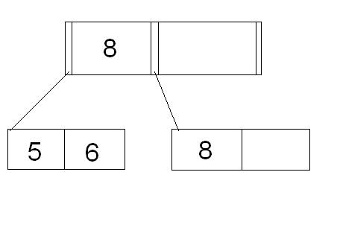
Inserting into B+ Trees (cont.)
After splitting the root, we would end up with this:

Slide 15
Inserting into B+ Trees (cont.)
Case 3: Adding to a full node
Suppose we wanted to insert 7 into our tree:

Slide 16
Inserting into B+ Trees (cont.)
7 goes with 5 and 6. However, since each node can only hold a maximum of 2 keys, we can take the median of all 3 (which would be 6), keep it with the left (5), and create a new leaf for 7.
An alternative way is to keep the median with the right and create a new leaf for 5.

Slide 17
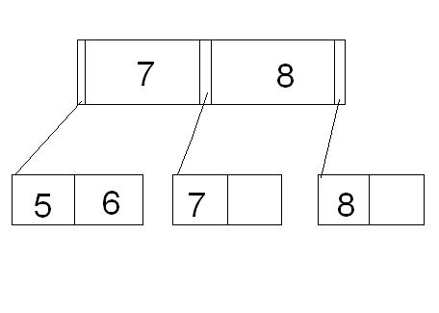
Inserting into B+ Trees (cont.)

Slide 18
Inserting into B+ Trees (cont.)
Case 4: Inserting on a full leaf, requiring a split at least 1 level up
Using the last tree, suppose we were to insert 4.

Slide 19
Inserting into B+ Trees (cont.)
We would need to split the leftmost leaf, which would require another split of the root.
A new root is created with the pointers referencing the old split root.

Slide 20
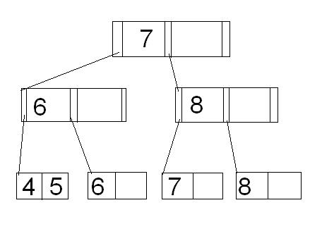
Inserting into B+ Trees (cont.)

Slide 21
Deleting from B+ Trees
Deletion, like insertion, begins with a search.
When the item to be deleted is located and removed, the tree must be checked to make sure no rules are violated.
The rule to focus on is to ensure that each node has at least ceil(n/2) pointers.

Slide 22
Deleting from B+ Trees (cont.)
Take the previous example:

Slide 23
Deleting from B+ Trees (cont.)
Suppose we want to delete 5.
This would not require any rebalancing since the leaf that 5 was in still has 1 element in it.

Slide 24
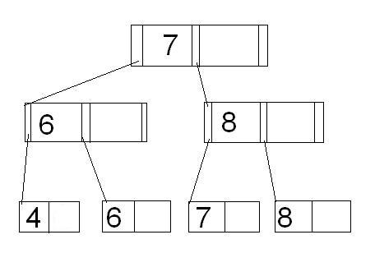
Deleting from B+ Trees (cont.)

Slide 25
Deleting from B+ Trees (cont.)
Suppose we want to remove 6.
This would require rebalancing, since removing the element 6 would require removal of the entire leaf (since 6 is the only element in that leaf).

Slide 26
Deleting from B+ Trees (cont.)
Once we remove the leaf node, the parent of that leaf node no longer follows the rule.
It has only 1 child, which is less than the 2 required ( ceil(3/2) = 2).
Then, the tree must be compacted in order to enforce this rule.

Slide 27
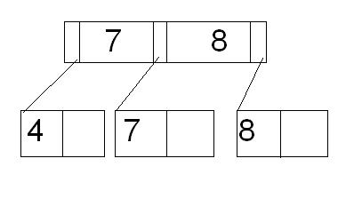
Deleting from B+ Trees (cont.)
The end product would look something like this:

Slide 28
Bibliography
Wikipedia
http://en.wikipedia.org/wiki/B_plus_tree
Silberschatz, Abraham, and Henry F. Korth, and S. Sundarshan. Database System Concepts. New York: McGraw-Hill, 2006.

